Slide 1
E-commerce Sales & Customer Segmentation Analysis
Optimizing product offerings, marketing, and revenue retention
Created by - Deeksha Gosain

Slide 2



OUTLINE
Executive Summary
Introduction
Methodology
Results
  Visualization – Charts
  Dashboard
Discussion
  Findings & Implications
Conclusion
Appendix

Slide 3

EXECUTIVE SUMMARY
The project was conducted to understand customer value distribution and engagement patterns within an e-commerce business, with the objective of enabling data-driven retention, upsell, and win-back strategies.
This project analyzes e-commerce transactional data to segment customers using RFM analysis and K-Means clustering.
Customer segmentation was performed using RFM analysis, categorizing users into four business-relevant segments:
  Active High Value Customers (77.23% revenue share with VVIP micro-segment found using K-Means Clustering)
  Inactive High Value Customers
  Active Low Value Customers
  Inactive Low Value Customers
The findings highlight a strong dependence on a small group of high-value customers, alongside clear growth opportunities in Active Low-Value customers through order-value expansion and in Inactive High-Value customers through targeted win-back initiatives.

Slide 4

INTRODUCTION
This project uses UCI Online Retail data for a non-store online retail store based in UK between Dec 2010 and Dec 2011, which contains transactions from 4339 customers worldwide.
Three key questions guide the analysis:
  How are customers distributed based on recency, purchase frequency, and monetary value?
  Which customer segments contribute the most to overall revenue?
  Are there distinct customer groups within high-value customers that require differentiated engagement strategies?
The goal of the analysis is to translate raw transaction data into actionable customer insights that support retention, upsell, and win-back decision-making.
The findings provide a structured view of customer value concentration, highlight growth opportunities across segments, and demonstrate how customer-level analytics can inform strategic decisions in an e-commerce context.

Slide 5

METHODOLOGY
Data Collection & Storage
  Downloaded retail transaction data from UCI Repository
  Modeled data using a star schema (fact & dimension tables) for structured analysis
Data Cleaning (SQL)
  Removed blanks and duplicates
  Filtered logically incorrect transactions (negative quantity and unit price)
Exploratory Data Analysis
  Analyzed distributions of recency, frequency, and revenue
  Identified right-skewed behavior to validate RFM segmentation
Customer Segmentation
  Applied RFM analysis to classify customers into four value-based segments
  Performed K-Means clustering to uncover deeper behavioral patterns
Dashboards

Slide 6
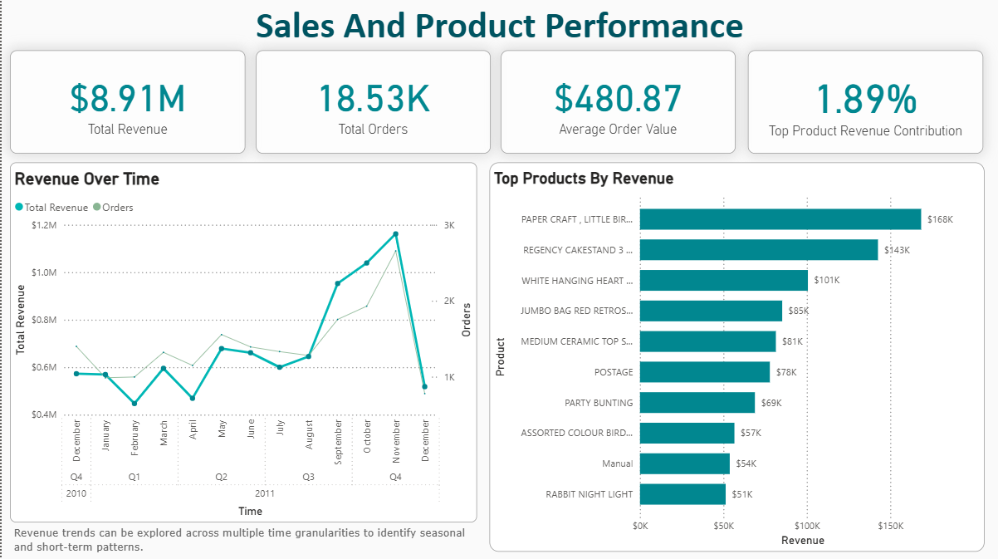
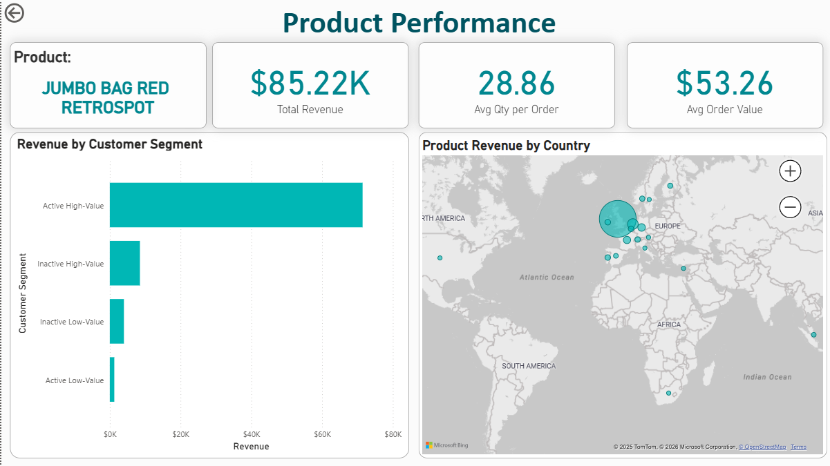
DASHBOARD TAB 1
Interactive view of revenue trends, product performance, and drill-through product insights across customer segments and geographies.

Slide 7
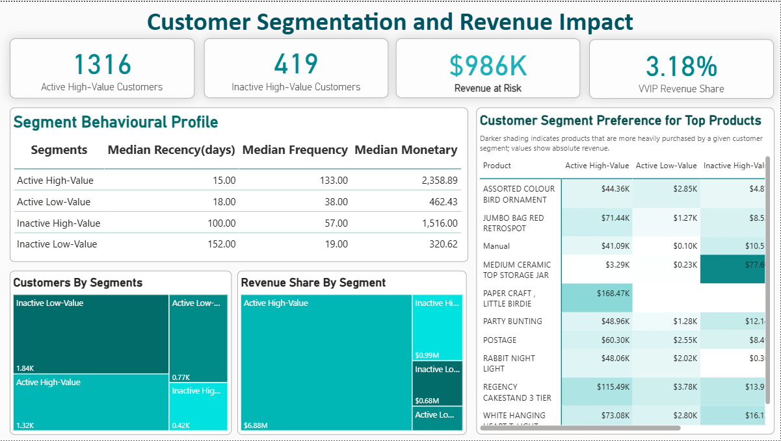
DASHBOARD TAB 2
Customer segmentation view highlighting revenue concentration, behavioral differences, and segment-level product preferences.

Slide 8
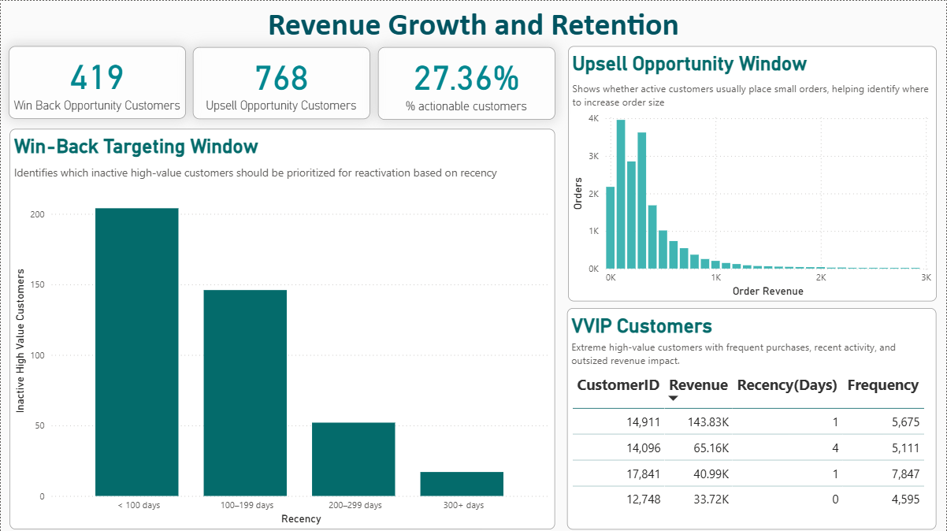
DASHBOARD TAB 3
Action-oriented view identifying upsell, win-back, and high-impact customer retention opportunities.

Slide 9
OVERALL FINDINGS & IMPLICATIONS
Findings
Revenue is highly concentrated among customer segments, with Active High-Value customers contributing 77% of total revenue, while Inactive High-Value customers represent $986K in revenue at risk.
K-Means clustering identified a VVIP micro-segment (4 customers) generating 3.18% of total revenue, characterized by extremely high frequency and recent activity.
Product revenue is highly diversified, with the top product contributing only 1.89% of total revenue, and some products generating high revenue from very low purchase frequency.
The UK dominates order volume, while Active Low-Value customers place frequent but small orders, creating a clear upsell opportunity window.
Implications
Retention of high-value customers is critical, and win-back strategies for inactive high-value customers offer high ROI compared to acquiring new customers.
VVIP customers require white-glove engagement to protect from revenue impact.
Top product’s revenue share shows that business is not dependent on a single product
AOV expansion strategies (bundles, minimum order thresholds, cross-sells) in the core UK market can unlock growth without increasing acquisition spend.

Slide 10

CONCLUSION
The analysis demonstrates that e-commerce revenue is primarily driven by customer behavior rather than individual products, with a small group of high-value customers accounting for a disproportionate share of total revenue.
Customer segmentation reveals a highly concentrated revenue structure, where retaining and protecting active high-value customers is critical, while inactive high-value customers present a strong win-back opportunity with higher expected returns than new customer acquisition.
Although product revenue is diversified, clear seasonal demand patterns and frequent low-value purchasing behavior indicate that future growth will be driven by average order value expansion, targeted retention, and personalized engagement strategies.
Overall, the findings highlight the importance of data-driven customer segmentation and behavioral analytics in guiding revenue growth, risk mitigation, and strategic decision-making in an e-commerce environment.

Slide 11
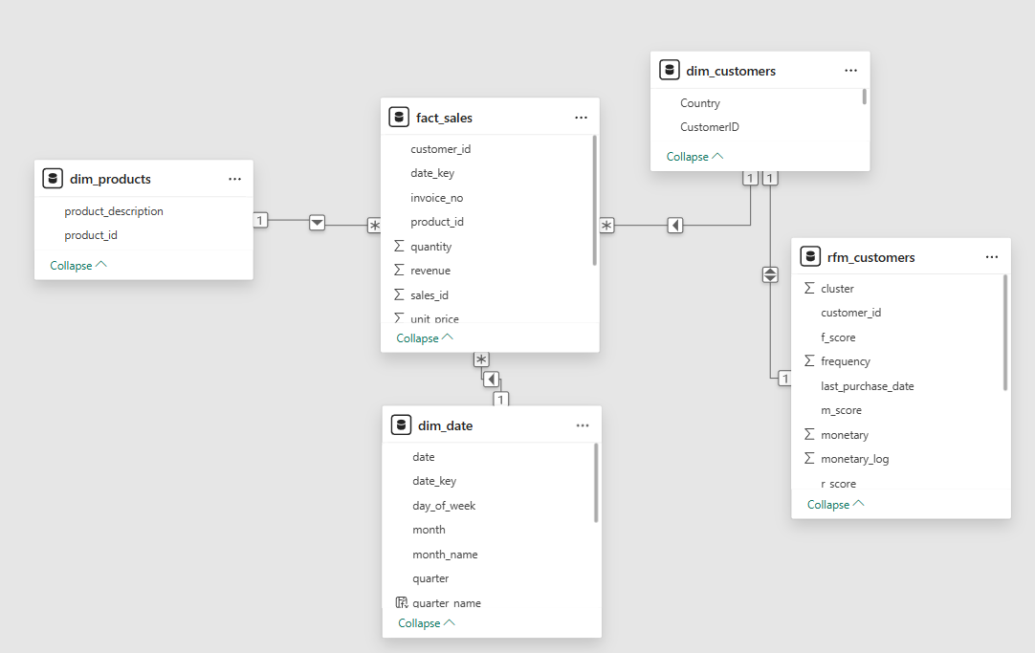

APPENDIX
Data Model used for this project

Slide 12
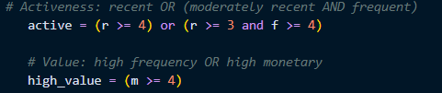
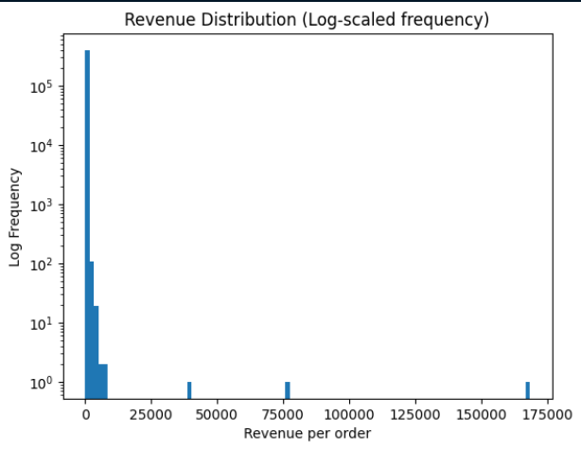
RFM Segmentation
Recency= days since last purchase
Frequency = total orders per customer
Monetary = total revenue per customer
Segmentation Logic
The adjacent distribution shows that revenue is highly right-skewed.
To prevent this skewness from disproportionately influencing the K-Means clustering results, a log transformation was applied to the monetary variable.
This transformation was not required for RFM segmentation, as RFM relies on relative scoring (1–5), which is robust to skewed distributions.

Slide 13

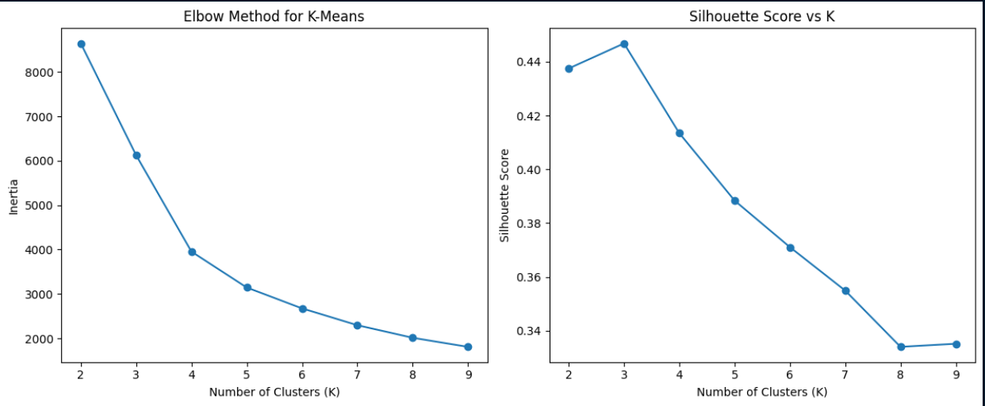
K-Means Clustering
Recency= days since last purchase
Frequency = total orders per customer
Monetary_log = log transformed total revenue per customer
Interpretation of clusters based on centroid analysis
Primarily Elbow method was used to determine K and silhouette score method was used as secondary method to determine k
From above methods value of K= 4 was used

